Slide 1


Machine Learning Project
Author：Long Shuyi

Slide 2
CONTENTS
01
Background
02
Project Process
03
Result

Slide 3
1
Background
PART

Slide 4
1
Theoretical Foundation
Fama-French three factor model
The Fame-French three factor model get high recognition among the world. It explain the return of stocks by factor research. It use three factors to explain the return of stocks. This three factor are market return, SMB and HML.
。
𝒓𝒊𝒕 = 𝜶𝒊 + 𝜷𝒊𝑴𝑹𝑴𝒕 + 𝜷𝒊𝑺𝑴𝑩𝑺𝑴𝑩𝒕 + 𝜷𝒊𝑯𝑴𝑳𝑯𝑴𝑳𝒕 + 𝒆𝒊𝒕
Other multi-factor model are based on this three factor model.

Slide 5
2
Factor types
Fundamental Factors | Market Value P/E ROA、ROE etc.
Technical Factors | Turnover VOSC OBV
Other Factors | Attention Factor etc.
In our project, we choose technical factors to predict stocks’ return.

Slide 6
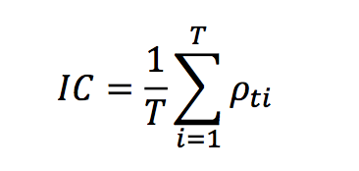
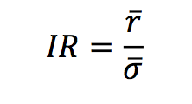
2
Factor efficiency evaluation
IC(information coefficiency):
(𝜌ti represent the coefficiency of the factor and the return at next term for stock i)
IR(information ratio):
The higher of these two indicators the better the factor.

Slide 7
2
Project process
PART

Slide 8
1
Getting Data
Close price: I get close price of every stocks in Shanghai stock market
from 2014 to 2016.
。
Turnover: I get turnover of every stocks in Shanghai stock market
from 2014 to 2016.
Index close price: I get close price of SH180 from 2014 to 2016.

Slide 9
2
Define factors
MTM(Momentum Index)
MTM factor=(close[20]-close[0])/close[0]
Average Turnover Rate
。
average turnover rate=turnover[0:20].mean()
Turnover Change
turnover change=average turnover rate[20]-average turnover rate[0]
Average Volatility
average volatility=Var(close[0:20])

Slide 10
2
Define factors
RSI(Relative Strength Index)
RS=[A÷B]×100%
(A:t he sum of price increase among N days . B: the sum of price decrease among N days)
。
RSI=100-100/(1+RS)
RSI is a very important indicator. If the number of RSI blow 20. It's price has high probability to go up. And if the number of RSI above 80. It's price has high probability to go down.

Slide 11
3
Process data
1.Delete new stocks. We only keep the original stocks in 2014.
2.Put all data into a matrix.
。
3.Standardize the data.

Slide 12
4
Return calculation
1.Calculate the return of index each 20 days(or a month) from 2014-2016
2.Calculate every stock return each 20 days(or a month) from 2014-2016
。
3.Compare the return of each stock and the return of index.
4.Estabilish a matrix. For stock ‘I’, if the return of it larger than the return of index. I label it as ‘1’. Otherwise, if the return of it smaller than the return of index. I label it as ‘-1’. Then fill in all the number into the matrix.

Slide 13
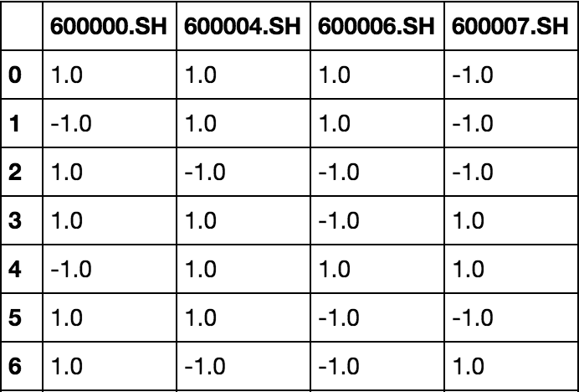
5
Data training
I have 3 years data that means we have 36 months data. I use the data at month t as the train set. And then I use data at month t+1 as test set. I can predict the return at month t+2 by using data of month t and month t+1. But what I predict is not the accurate number of the return but what stocks will have larger return than index. The result is like below:
。

Slide 14
5
Stock selection
I already get the result. And I predict the stock which price will go up .So I choose stocks from the pool where there are stocks predicted to go up. But I do not choose all of them. I give them a order by RSI indicator. I choose the smallest 10 of RSI stocks and buy it. I repeat this procedure every month until the last month in 2016.
。

Slide 15
3
Result
PART

Slide 16
The red line is the accumulation of the strategy. The blue line is the return of the index(SZ180). We can see that the result of the strategy is good. The total return of the fund is 609% for three years. The annual return is 82.6%. It also experience a loss in 2015 because the market in that period is really bad.
。

